Slide 1
Chapter 6
Entity Relationship (ER) Modelling

Slide 2
Entity-Relationship Model
Dia – A program for drawing structured diagrams
Design Process
Modeling
Constraints
E-R Diagram
Design Issues
Weak Entity Sets
Extended E-R Features

Slide 3
Dia
These notes have been created with Dia.
Dia is an open source diagramming tool with many different diagram templates.
It can be downloaded free from
dia-installer.de/
There are other applications that allow you to create ER diagrams such as: Smartdraw© (only 7 day free licence) or Microsoft Visio

Slide 4
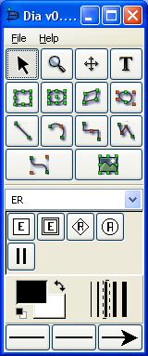
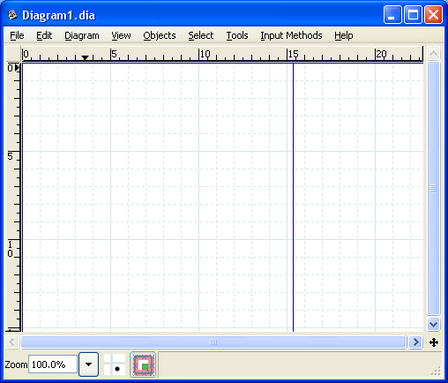
Dia
Fig 5.1 Dia

Slide 5
The Entity Relationship (ER) Model
ER model forms the basis of an ER diagram
ERD represents the conceptual database as viewed by end user
ERDs depict the ER model’s three main components:
Entities
Attributes
Relationships

Slide 6
Modeling
A database can be modeled as:
a collection of entities,
relationship among entities.
An entity is an object that exists and is distinguishable from other objects.
Example: specific person, company, event, plant
Entities have attributes
Example: people have names and addresses
An entity set is a set of entities of the same type that share the same properties.
Example: set of all persons, companies, trees, holidays

Slide 7
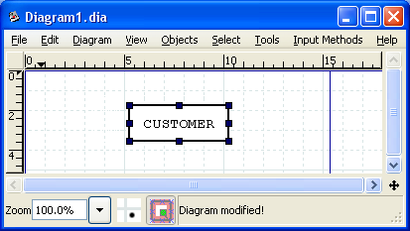
Entities
Refers to the entity set and not to a single entity occurrence
Corresponds to a table and not to a row in the relational environment
Entity name, a noun, is usually written in capital letters.
Just drag the entity
Symbol over to the work
space, the rectangle will
then be automatically
displayed. Double click
to enter in name

Slide 8
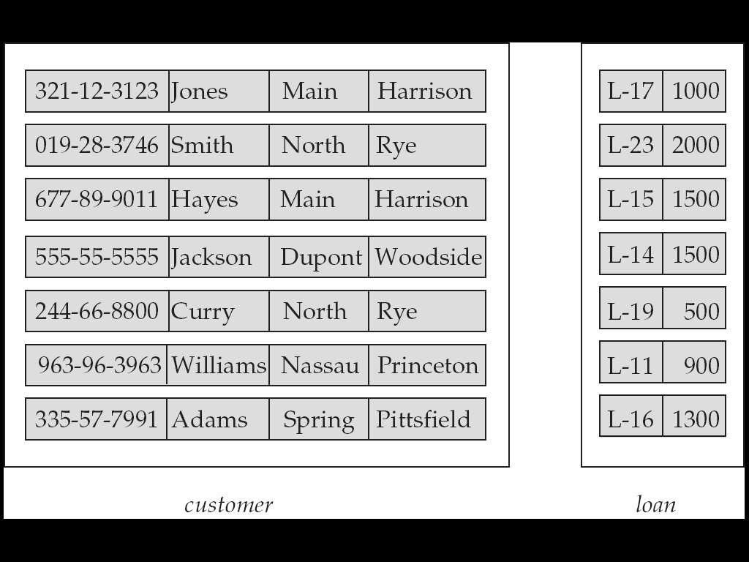
Entity Sets customer and loan
customer_id customer_Name customer_street customer_city loan_number amount

Slide 9
Relationship Sets
A relationship is an association among several entities
Example: Hayes depositor A-102
customer entity relationship set account entity

Slide 10
Relationship Sets (Cont.)
A relationship set is a mathematical relation among n ≥ 2 entities, each taken from entity sets
{(e₁, e₂, … e_{n}) | e₁ ∈ E₁, e₂ ∈ E₂, …, e_{n} ∈ E_{n}} where (e₁, e₂, …, e_{n}) is a relationship
Example:
(Hayes, A-102) ∈ depositor

Slide 11
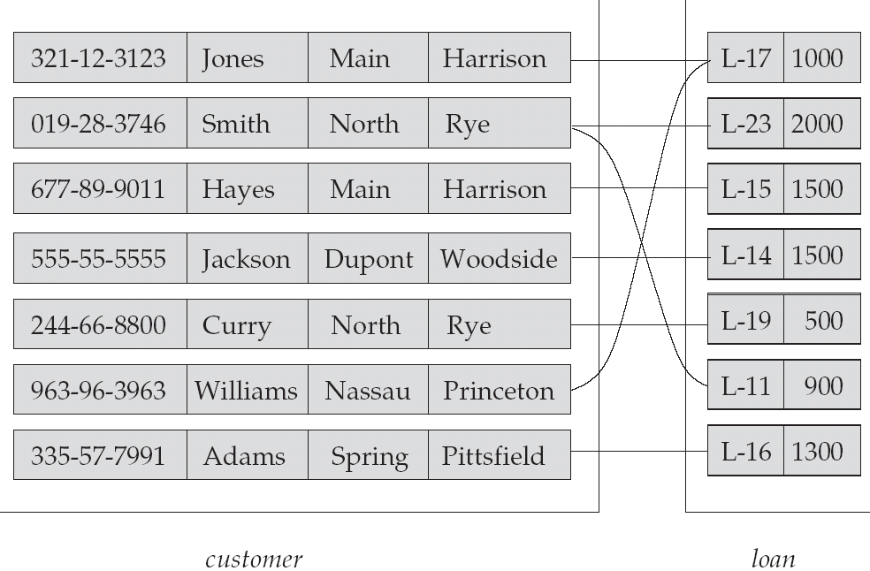
Relationship Set borrower

Slide 12
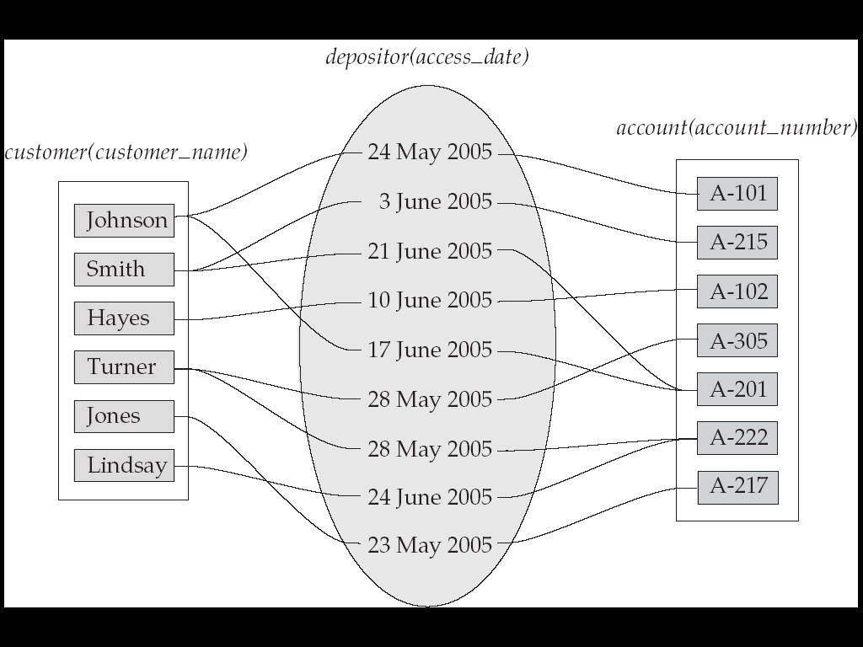
Relationship Sets (Cont.)
An attribute can also be property of a relationship set.
For instance, the depositor relationship set between entity sets customer and account may have the attribute access-date

Slide 13
Degree of a Relationship Set
Refers to number of entity sets that participate in a relationship set.
Relationship sets that involve two entity sets are binary (or degree two). Generally, most relationship sets in a database system are binary.
Relationship sets may involve more than two entity sets.
Relationships between more than two entity sets are rare. Most relationships are binary. (More on this later.)
Example: Suppose employees of a bank may have jobs (responsibilities) at multiple branches, with different jobs at different branches. Then there is a ternary relationship set between entity sets employee, job, and branch

Slide 14
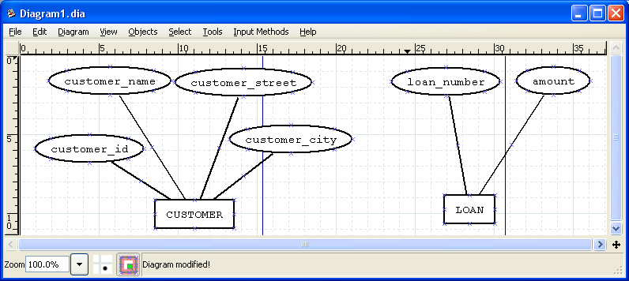
Attributes
An entity is represented by a set of attributes, that is descriptive properties possessed by all members of an entity set.
Example:
customer = (customer_id, customer_name, customer_street, customer_city ) loan = (loan_number, amount )

Slide 15
Attributes (Cont.)
Domain – the set of permitted values for each attribute
Attribute types:
Simple and composite attributes.
Single-valued and multi-valued attributes
Example: multivalued attribute: phone_numbers
Derived attributes
Can be computed from other attributes
Example: age, given date_of_birth

Slide 16
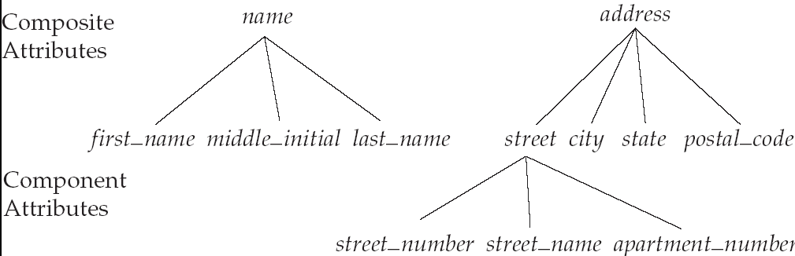
Composite Attributes

Slide 17
Mapping Cardinality Constraints
Express the number of entities to which another entity can be associated via a relationship set.
Most useful in describing binary relationship sets.
For a binary relationship set the mapping cardinality must be one of the following types:
One to one
One to many
Many to one
Many to many

Slide 18
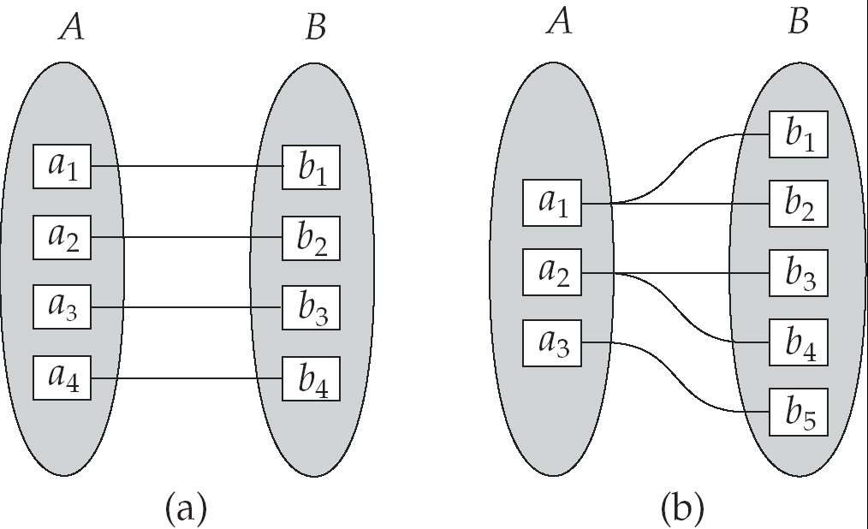
Mapping Cardinalities
One to one
One to many
Note: Some elements in A and B may not be mapped to any elements in the other set

Slide 19
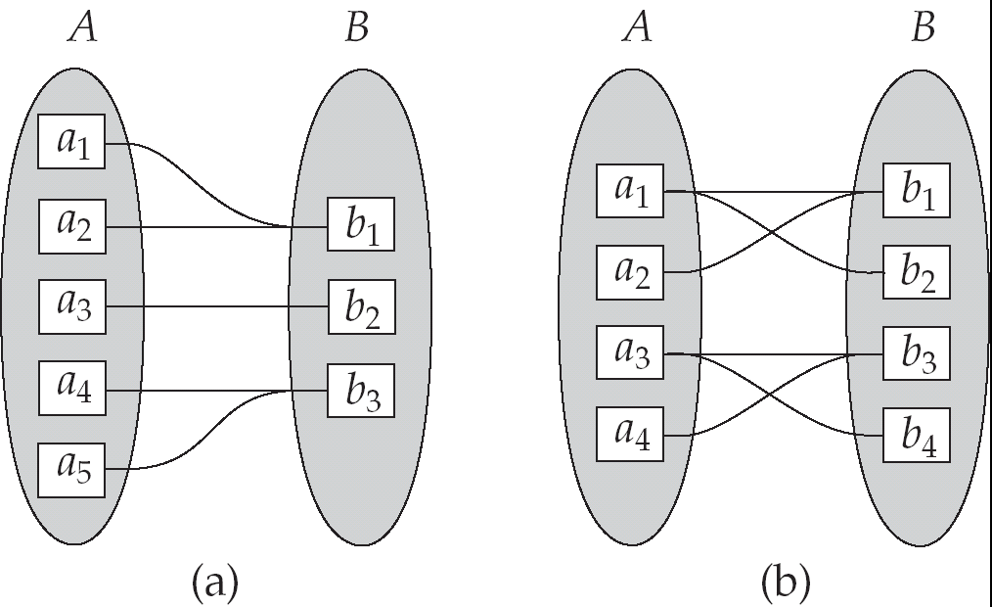
Mapping Cardinalities
Many to one
Many to many
Note: Some elements in A and B may not be mapped to any elements in the other set

Slide 20
Keys
A super key of an entity set is a set of one or more attributes whose values uniquely determine each entity.
A candidate key of an entity set is a minimal super key
Customer_id is candidate key of customer
account_number is candidate key of account
Although several candidate keys may exist, one of the candidate keys is selected to be the primary key.

Slide 21
Keys for Relationship Sets
The combination of primary keys of the participating entity sets forms a super key of a relationship set.
(customer_id, account_number) is the super key of depositor
NOTE: this means a pair of entity sets can have at most one relationship in a particular relationship set.
Example: if we wish to track all access_dates to each account by each customer, we cannot assume a relationship for each access. We can use a multivalued attribute though

Slide 22
Keys for Relationship Sets (Cont.)
Must consider the mapping cardinality of the relationship set when deciding the what are the candidate keys
Need to consider semantics of relationship set in selecting the primary key in case of more than one candidate key

Slide 23
Primary Keys
Underlined in the ER diagram
Key attributes are also underlined in frequently used table structure shorthand
Ideally composed of only a single attribute
Possible to use a composite key:
Primary key composed of more than one attribute

Slide 24
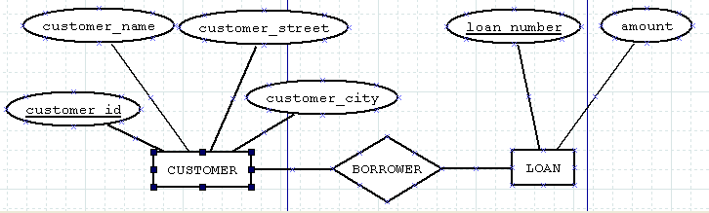
E-R Diagrams
Rectangles represent entity sets.
Diamonds represent relationship sets.
Lines link attributes to entity sets and entity sets to relationship sets.
Ellipses represent attributes
Double ellipses represent multivalued attributes.
Dashed ellipses denote derived attributes.
(more on these next…)
Underline indicates primary key attributes (will study later)

Slide 25
Resolving Multivalued Attribute Problems
Although the conceptual model can handle multivalued attributes, you should not implement them in the relational DBMS
Within original entity, create several new attributes, one for each of the original multivalued attribute’s components
Can lead to major structural problems in the table
Create a new entity composed of original multivalued attribute’s component

Slide 26
Derived Attributes
Attribute whose value may be calculated (derived) from other attributes
Need not be physically stored within the database
Can be derived by using an algorithm

Slide 27
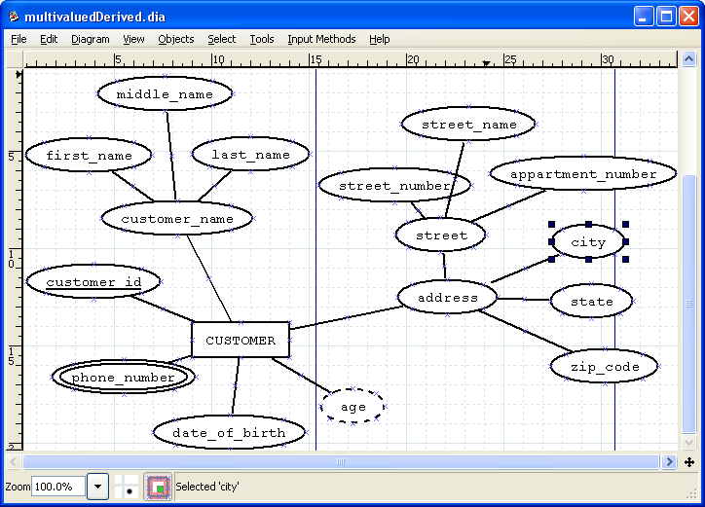
E-R Diagram With Composite, Multivalued, and Derived Attributes

Slide 28
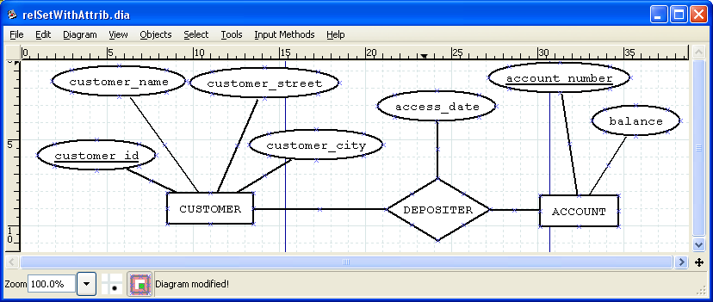
Relationship Sets with Attributes

Slide 29
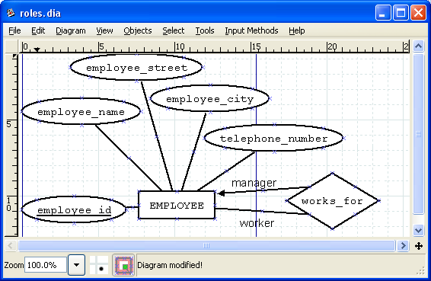
Roles
Entity sets of a relationship need not be distinct
The labels “manager” and “worker” are called roles; they specify how employee entities interact via the works_for relationship set.
Roles are indicated in E-R diagrams by labeling the lines that connect diamonds to rectangles.
Role labels are optional, and are used to clarify semantics of the relationship

Slide 30
Cardinality Constraints
We express cardinality constraints by drawing either a directed line (→), signifying “one,” or an undirected line (—), signifying “many,” between the relationship set and the entity set.
One-to-one relationship:
A customer is associated with at most one loan via the relationship borrower
A loan is associated with at most one customer via borrower

Slide 31
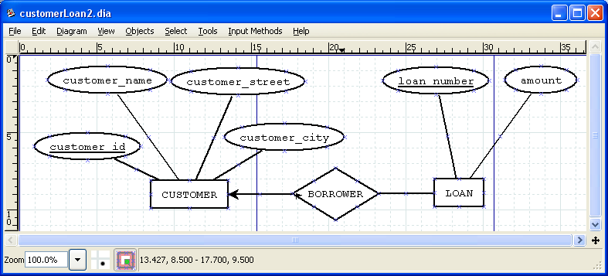
One-To-Many Relationship
In the one-to-many relationship a loan is associated with at most one customer via borrower, a customer is associated with several (including 0) loans via borrower

Slide 32
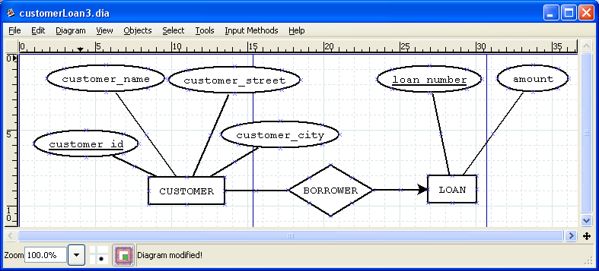
Many-To-One Relationships
In a many-to-one relationship a loan is associated with several (including 0) customers via borrower, a customer is associated with at most one loan via borrower

Slide 33
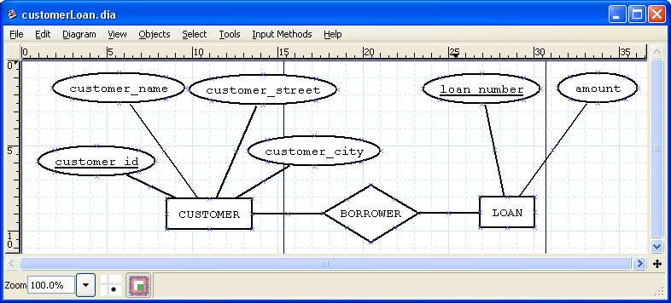
Many-To-Many Relationship
A customer is associated with several (possibly 0) loans via borrower
A loan is associated with several (possibly 0) customers via borrower

Slide 34

Participation of an Entity Set in a Relationship Set
Total participation (indicated by double line): every entity in the entity set participates in at least one relationship in the relationship set
E.g. participation of loan in borrower is total
every loan must have a customer associated to it via borrower
Partial participation: some entities may not participate in any relationship in the relationship set
Example: participation of customer in borrower is partial

Slide 35
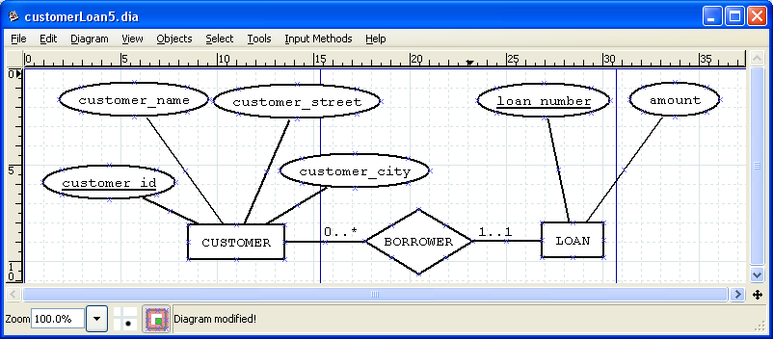
Alternative Notation for Cardinality Limits
Cardinality limits can also express participation constraints
There are other models such as crows foot, Chen model etc…

Slide 36
Relationship Degree
Indicates number of associated entities or participants
Unary relationship
Association is maintained within a single entity
Binary relationship
Two entities are associated
Ternary relationship
Three entities are associated
Notes on this in supplement on Moodle

Slide 37
Weak Entity Sets
An entity set that does not have a primary key is referred to as a weak entity set.
The existence of a weak entity set depends on the existence of an identifying entity set
it must relate to the identifying entity set via a total; one-to-many relationship set from the identifying to the weak entity set
Identifying relationship depicted using a double diamond

Slide 38
Weak Entity Sets (Cont.)
The discriminator (or partial key) of a weak entity set is the set of attributes that distinguishes among all the entities of a weak entity set.
The primary key of a weak entity set is formed by the primary key of the strong entity set on which the weak entity set is existence dependent, plus the weak entity set’s discriminator.

Slide 39
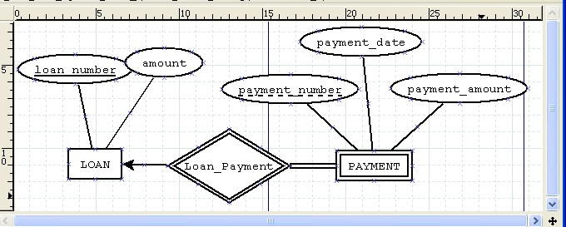
Weak Entity Sets (Cont.)
We depict a weak entity set by double rectangles.
We underline the discriminator of a weak entity set with a dashed line.
payment_number – discriminator of the payment entity set
Primary key for payment – (loan_number, payment_number)

Slide 40
Weak Entity Sets (Cont.)
Note: the primary key of the strong entity set is not explicitly stored with the weak entity set, since it is implicit in the identifying relationship.
If loan_number were explicitly stored, payment could be made a strong entity, but then the relationship between payment and loan would be duplicated by an implicit relationship defined by the attribute loan_number common to payment and loan

Slide 41
Recursive Relationships
Relationship can exist between occurrences of the same entity set
Naturally found within a unary relationship

Slide 42
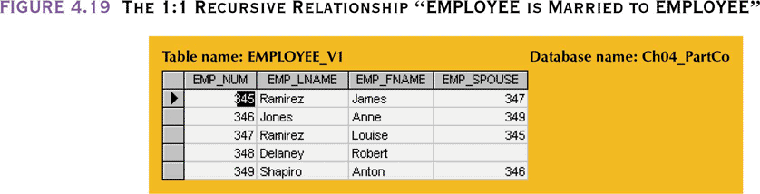
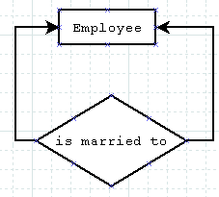
The 1:1 Recursive Relationship “EMPLOYEE is Married to EMPLOYEE”

Slide 43
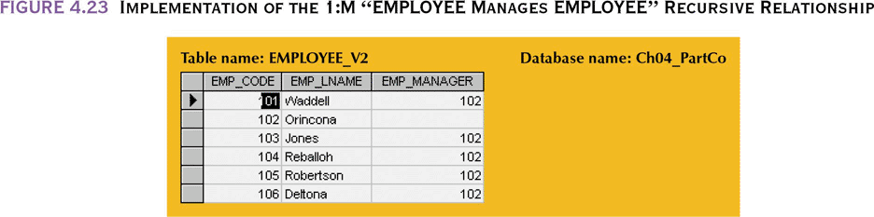
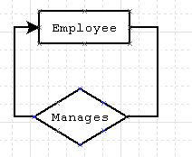
Implementation of the 1:M “EMPLOYEE Manages EMPLOYEE” Recursive Relationship

Slide 44
Extended E-R Features: Specialization
Top-down design process; we designate subgroupings within an entity set that are distinctive from other entities in the set.
These subgroupings become lower-level entity sets that have attributes or participate in relationships that do not apply to the higher-level entity set.
Depicted by a triangle component labeled ISA (E.g. customer “is a” person).
Attribute inheritance – a lower-level entity set inherits all the attributes and relationship participation of the higher-level entity set to which it is linked.

Slide 45
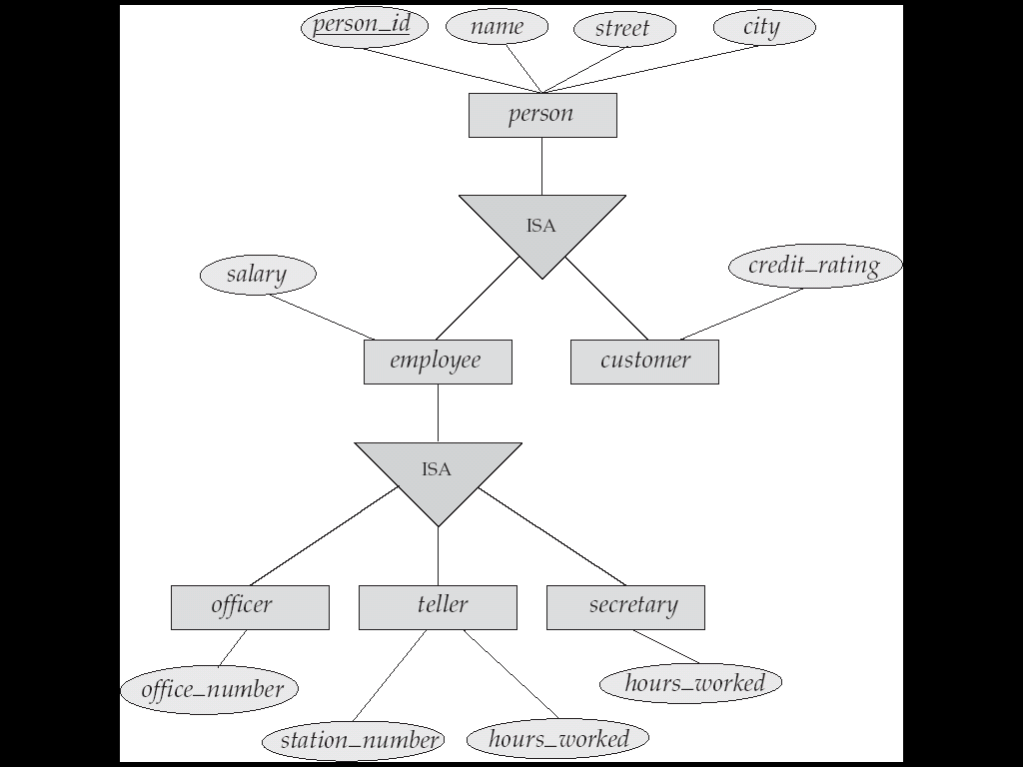
Specialization Example

Slide 46
Extended ER Features: Generalization
A bottom-up design process – combine a number of entity sets that share the same features into a higher-level entity set.
Specialization and generalization are simple inversions of each other; they are represented in an E-R diagram in the same way.
The terms specialization and generalization are used interchangeably.

Slide 47
Specialization and Generalization (Cont.)
Can have multiple specializations of an entity set based on different features.
E.g. permanent_employee vs. temporary_employee, in addition to officer vs. secretary vs. teller
Each particular employee would be
a member of one of permanent_employee or temporary_employee,
and also a member of one of officer, secretary, or teller
The ISA relationship also referred to as superclass - subclass relationship

Slide 48
Design Constraints on a Specialization/Generalization
Constraint on which entities can be members of a given lower-level entity set.
condition-defined
Example: all customers over 65 years are members of senior-citizen entity set; senior-citizen ISA person.
user-defined

Slide 49
E-R Design Decisions
The use of an attribute or entity set to represent an object.
Whether a real-world concept is best expressed by an entity set or a relationship set.
The use of a ternary relationship versus a pair of binary relationships.
The use of a strong or weak entity set.
The use of specialization/generalization – contributes to modularity in the design.

Slide 50
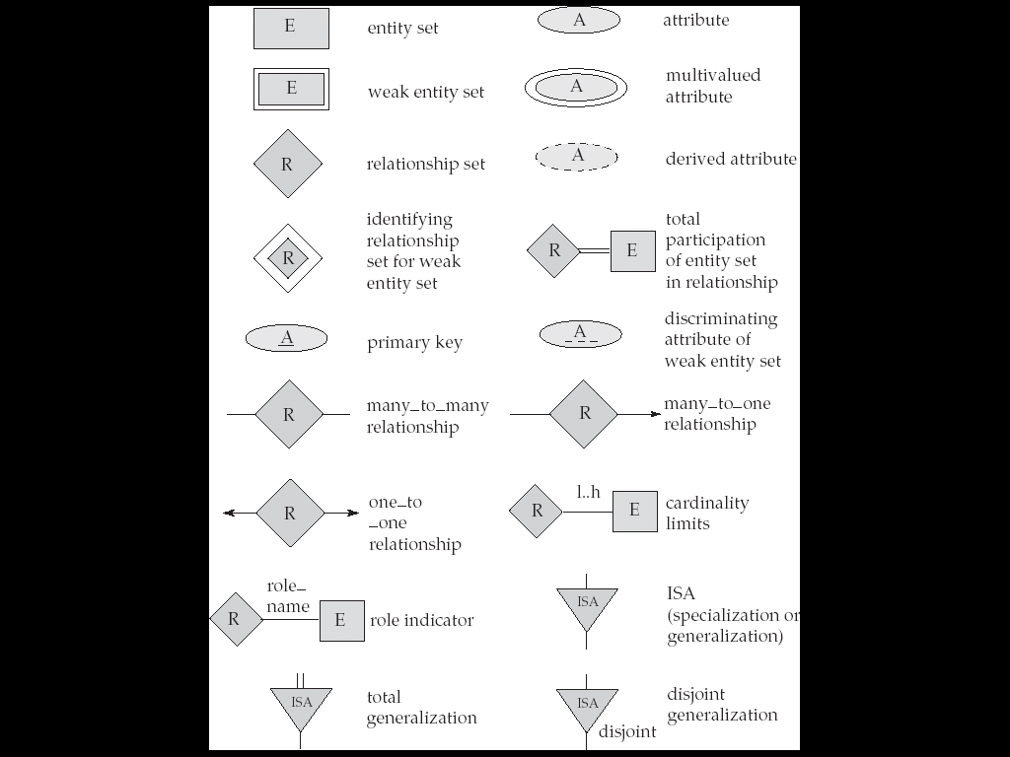
Summary of Symbols Used in E-R Notation

Slide 51
Reduction to Relation Schemas
Primary keys allow entity sets and relationship sets to be expressed uniformly as relation schemas that represent the contents of the database.
A database which conforms to an E-R diagram can be represented by a collection of schemas.
For each entity set and relationship set there is a unique schema that is assigned the name of the corresponding entity set or relationship set.
Each schema has a number of columns (generally corresponding to attributes), which have unique names.

Slide 52
Representing Entity Sets as Schemas
A strong entity set reduces to a schema with the same attributes.
A weak entity set becomes a table that includes a column for the primary key of the identifying strong entity set
payment =
( loan_number, payment_number, payment_date, payment_amount )

Slide 53
Representing Relationship Sets as Schemas
A many-to-many relationship set is represented as a schema with attributes for the primary keys of the two participating entity sets, and any descriptive attributes of the relationship set.
Example: schema for relationship set borrower
borrower = (customer_id, loan_number )

Slide 54
The Challenge of Database Design: Conflicting Goals
Database design must conform to design standards
High processing speeds are often a top priority in database design
Quest for timely information might be the focus of database design

